Slide 1
MULESOFT QUIZ QUESTIONS

Slide 2
Quiz Rules
The quizzes consists of questions carefully designed to help you self-assess your comprehension of the information presented on the topics covered in the module.
Each question in the quiz is of multiple-choice format
The quiz will consist of 3 questions.
Each question will generally have four options, and participants must choose the correct answer.
You can only submit your answers once.
For each question, we will select three candidates with the correct answers, and then we will randomly select one from the top three with the help of an online tool.
Participants will earn points for each correct answer, and the winner will be chosen at the final session.
The top 3 participants will be chosen based on the number of right questions answered, and then we will randomly choose one lucky winner from the top 3.
We will be maintaining all the participants ranks with us.
For each question, there will be only one participant who gives the fastest right answer, and they are not allowed to give multiple answers to the same question.

Slide 3
Day 11

Slide 4
1. What is the purpose of the Mock component in MUnit?
To simulate the behavior of external systems or services
To define the test cases for a MuleSoft application
To define the MuleSoft application's configuration
To define the MUnit test case's configuration
Answer: A

Slide 5
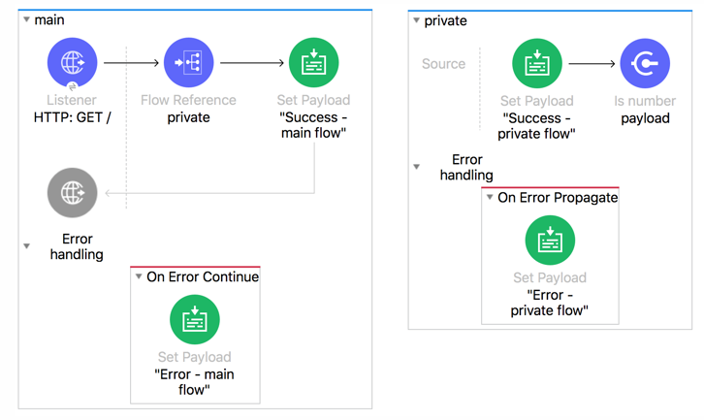
2. Refer to the exhibits. The main flow has an On Error Continue scope and the private flow has an On Error Propagate scope. A web client makes an HTTP GET request to the HTTP Listener. The Is number validator in the private flow then throws an error with message "Validate - Payload is an Integer". What response message is returned to the web client?
Success – private flow
Success – main flow
Error – main flow
Error – private flow
Answer: C

Slide 6
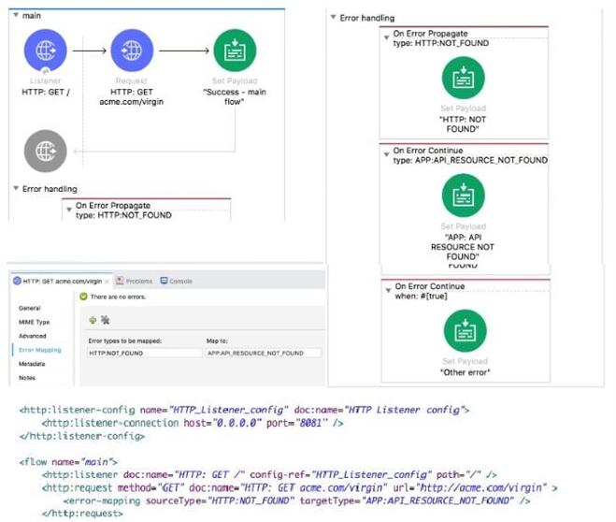
3. Refer to the exhibit. The main flow is configured with their error handlers. A web client submit a request to the HTTP Listener and the HTTP Request throws an HTTP:NOT_FOUND error. What response message is returned?''
APP: API RESOURCE NOT FOUND
HTTP: NOT FOUND
Other error
Success – main flow
Answer: A

